Slide 1
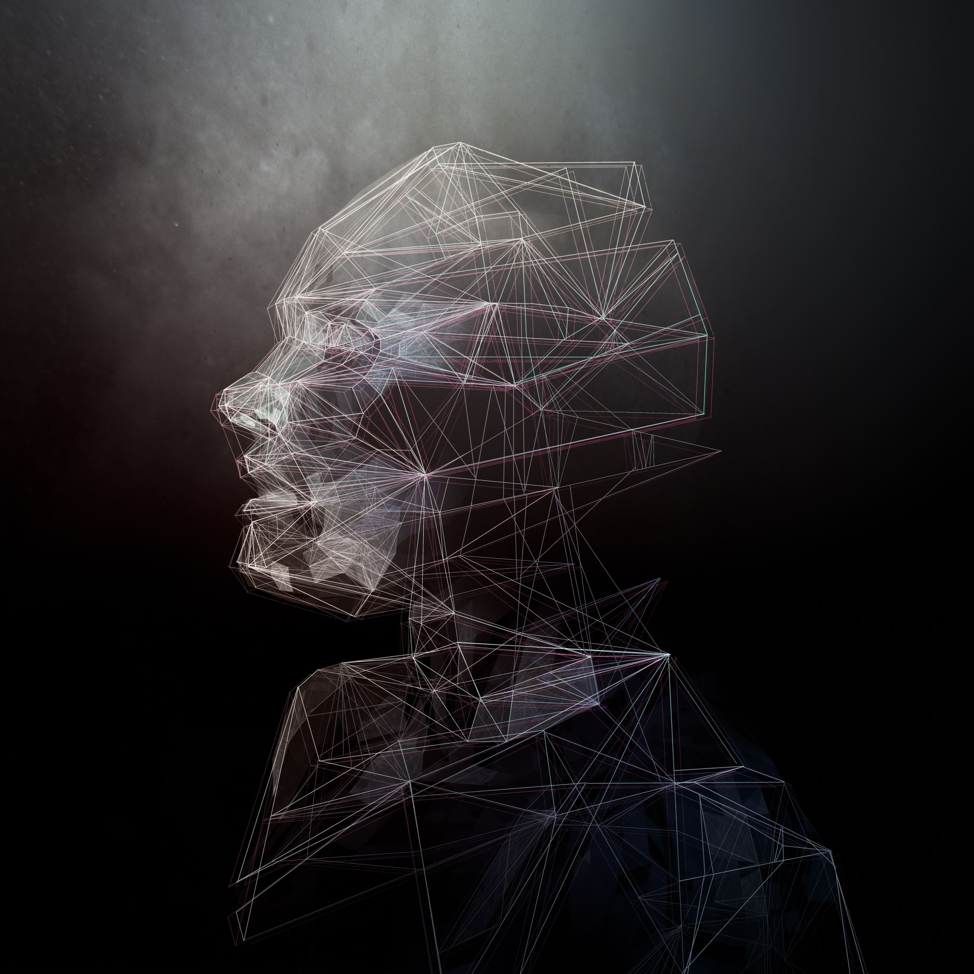
Face Recognition for ID Login
Implementing Face Recognition for Secure Login with Streamlit
Notes:
Good afternoon, I am Alvaro and I will guide you through this project that uses face recognition to implement and ID login system.

Slide 2
Introduction
Using face recognition models for secure login
Implementing the system with Streamlit
Key technologies: VGG16, DeepFace, SVM
Notes:
The idea is a secure login that uses facial recognition to unlock an app, avoiding the security risks that traditional passwords have. The app is implemented using Streamlit and is a very simplelogin prompt that if successful login will show you the user and the content of the site.
As technologies, 3 different approaches and libraries have been used for this app with the goal to compare them: VGG16, DeepFace and SVM. More details later.

Slide 3
Goal of the Project
to use face recognition models
Compare
Accuracy across different models
Leverage
Popular libraries
Implement
Login system for a website
Learn
Notes:
The goals of the project are very straight forward, To learn and use different face recognition models, then be able to compare their performance between them, leverage the vast amount of libraries already available to use and finally to implement all of this on a useful final product.

Slide 4
Motivation
• Face recognition is widely used in security and biometrics
• Challenges with training from scratch
• Importance of using pre-trained models
Notes:
Motivations are the Increasingly number of companies such as apple or Microsoft adopting this biometric security methods to improve over the traditional methods like passwords or pin codes. With this the challenges that arise by trying to create such a model from scratch and here comes the importance of using libraries and public resources that are available. Facebook or apple have more data and more powerful machines than what we could ever afford, but we can discuss that later.

Slide 5
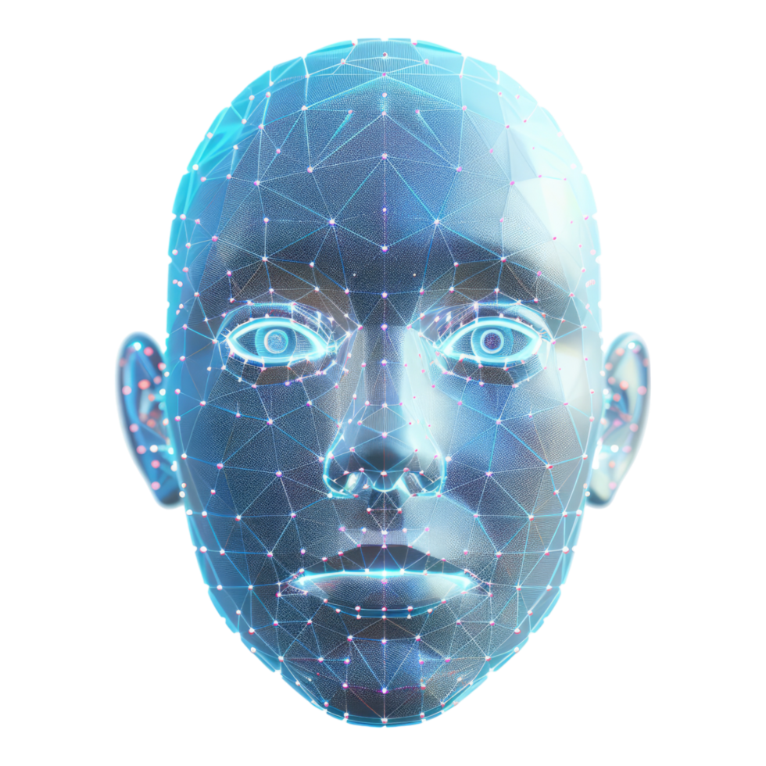
Change in Direction
Initially planned live face recognition
Issues with OpenCV (cv2) and Streamlit
TensorFlow and Pytorch not recognizing GPU
Adjusted to user-uploaded image approach
Comparison of 3 different approaches
Notes:
A little bit of a change in direction, the idea was to implement a live face recognition, but problems with libraries cv2 and streamlit make the video feed not possible as an app. Also for training the model from scratch, was unable to make tensorflow or Pytorch recognize the GPU with CUDA cores. Hence training was very slow.
Adjusted to use just image instead of video and do a comparison.

Slide 6
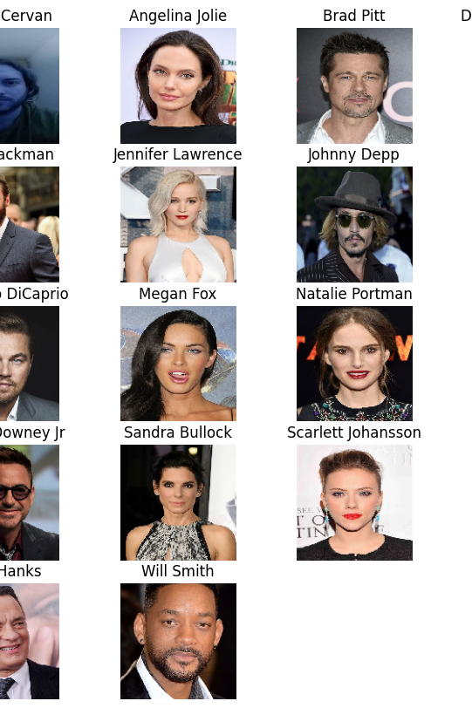
Dataset Used
Celebrity Face Image Dataset (Kaggle)
17 celebrity classes +
1 Custom class for the student from a 13-second video
Notes:
Dataset is a very famous Kaggle dataset with 1800 images from 17 celebrities plus a custom person, me from a video

Slide 7
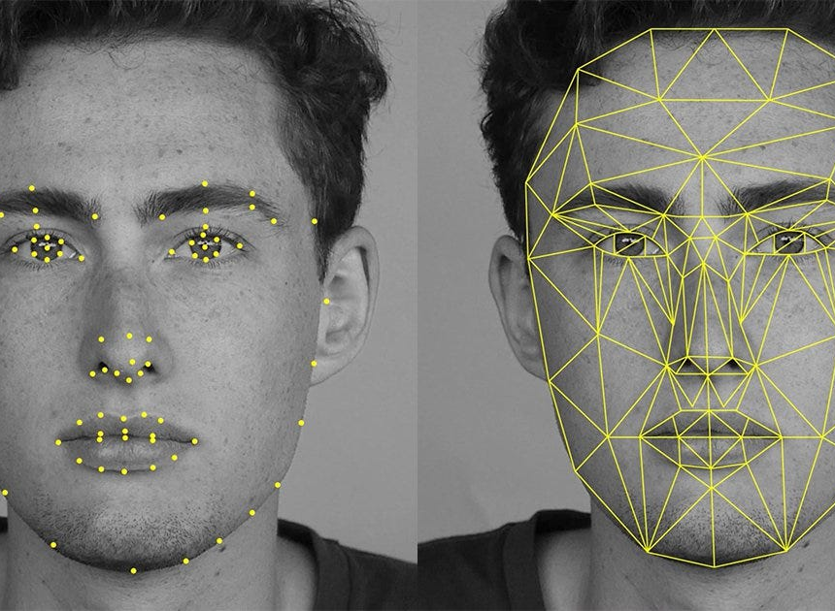
Extracting Data from Video
Video split into frames
Frames saved as training images
Preprocessing done for consistency
Total ~400 Images
Notes:
Video is processed by splitting it into frames. Processing it for consistency and reduce unnecessary information, with a total of almost 400 images

Slide 8
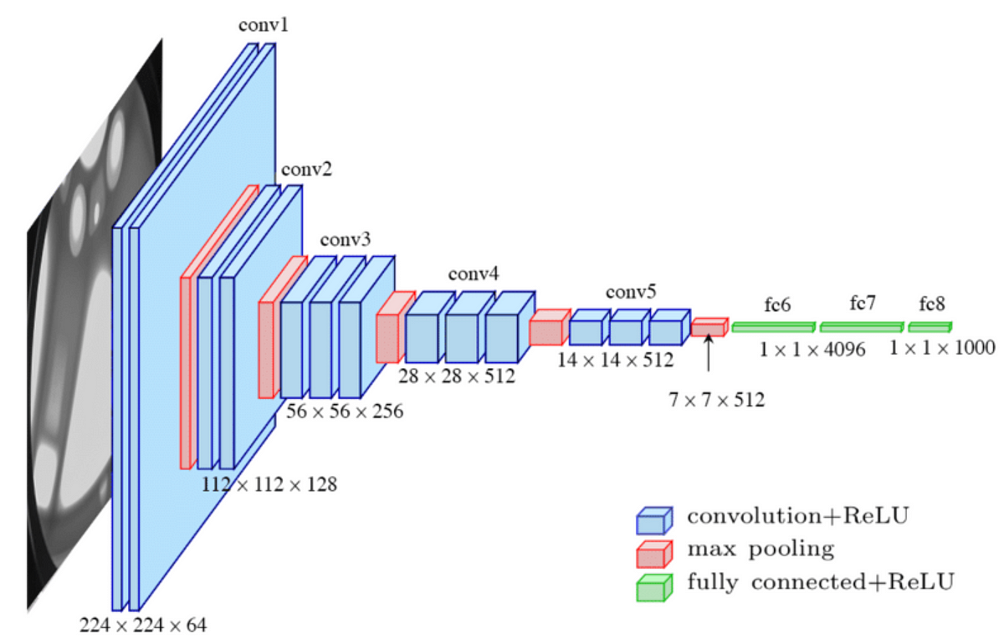
Model 1 - Fine-Tuned VGG16
Pre-trained model used for feature extraction
Additional dense layers for classification
Training on the dataset (very fast)
Notes:
Now we start with the first model. Here we use a pretrained model VGG16 for extraction of the features for the facial recognition. This step was the most time consuming, the tuning for 100 epochs takes a few seconds. This is way faster and better results than training from scratch, where 20 Epochs would take more than 20 minutes for a less than 20% accuarcy

Slide 9
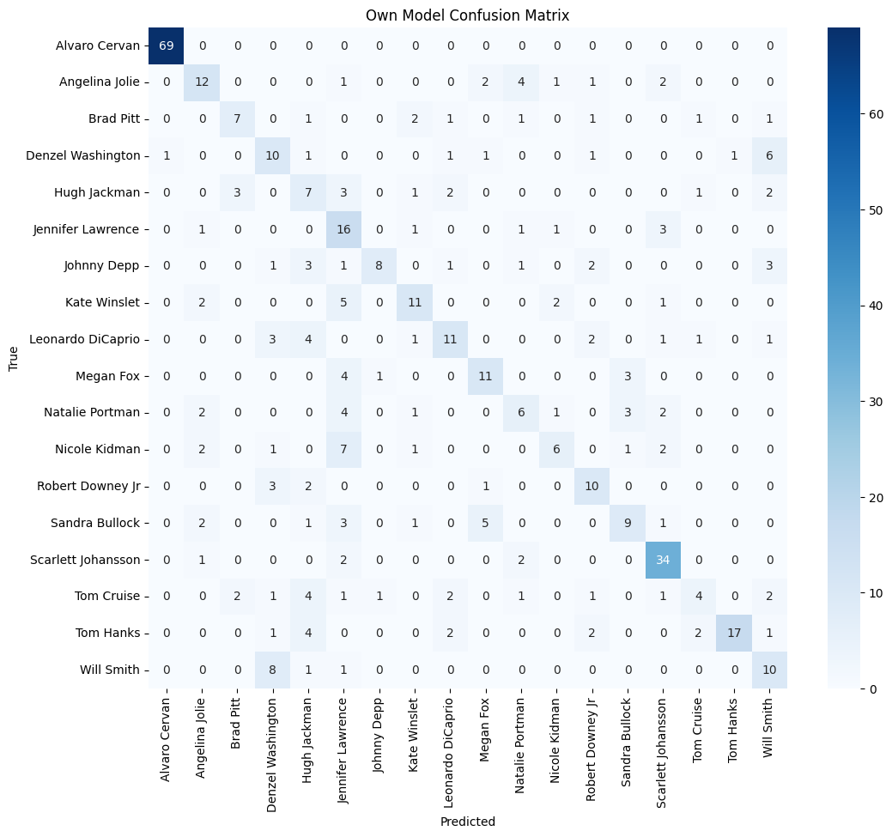
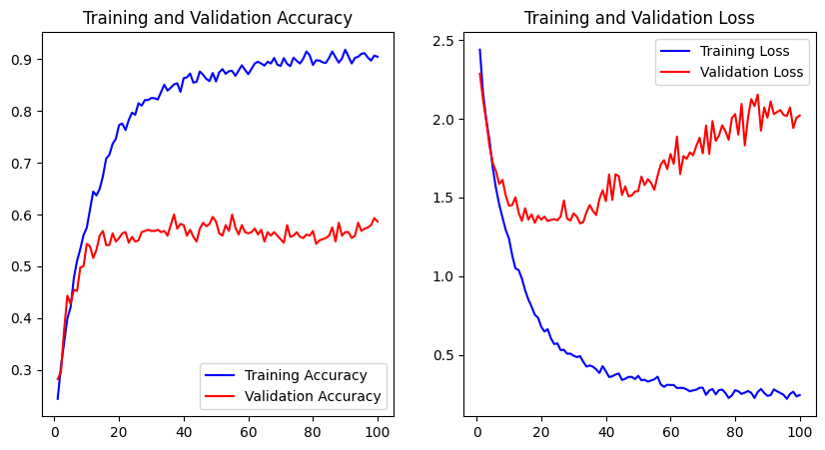
Training Results - VGG16
Accuracy over epochs ~25
Difference in loss and accuracy graphs
Overfitting challenges
Results change with each model training
Notes:
As we can see, training and validation values differ greatly, implying overfitting. The model is learning the images from the training but not generalizing and recognizing its features. We can also see it on my face, where it performs nearly perfect, but all images are similar as they come from a single video.
Accuracy: 58.64%

Slide 10
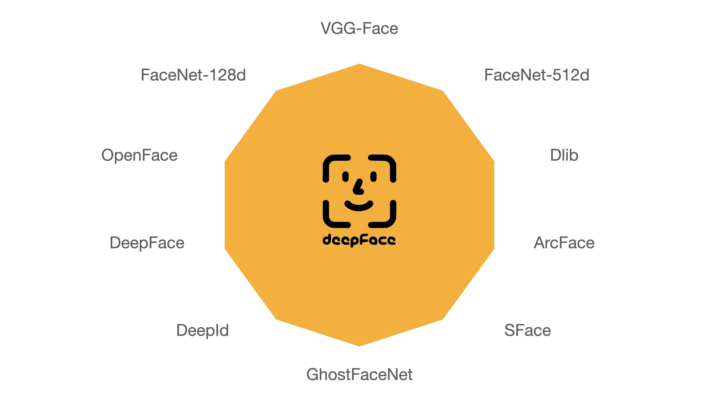
Model 2 - DeepFace Approach
Uses pre-trained deep learning model
Matches faces by similarity rather than classification
Achieved 73.7% accuracy*
Notes:
Second model is a very popular python library called DeepFace, used for face recognition and facial attribute analysis. Its lightweight and leverages state of the art models like VGG Face, Facenet etc.
This model does not work by classifying images, but by comparison with a sample image.
Instead of using the dataset, only 1 sample image per class (actor) is used for comparing the image provided. This makes the dataset more manageable, smaller in size and hence faster.Maybe it would be not so scalable for huge datasets?
This model achieved almost a 74% of accuracy with the dataset. In this case, the full correct class (folder with images) was compared 1 by 1 to the sample image and counted the true positives.
This is why the following confusion matrix is a bit different

Slide 11
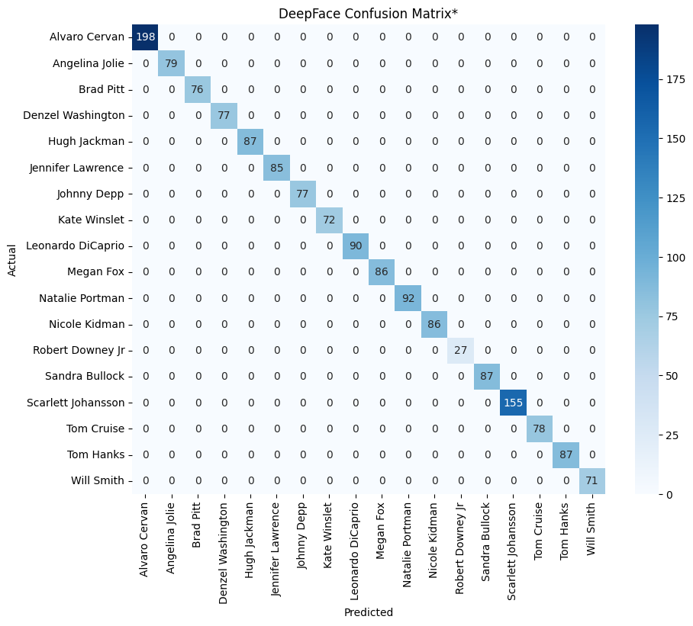
DeepFace - Confusion Matrix
Special confusion Matrix
Not a classifier but by Comparison
Only True Positives
Divided by total
True Positives = 1619
Total Images = 2197
Accuracy = 73.7%
Notes:
Comparison of images of faces from database to our dataset, true or false if in database, not classifier.
Nevertheless, we can see that most classes are above 70% (total of 100) except Robert Downey Jr. Alvaro (me) is at about 50% while Scarlet Johhanson is at 75%.

Slide 12
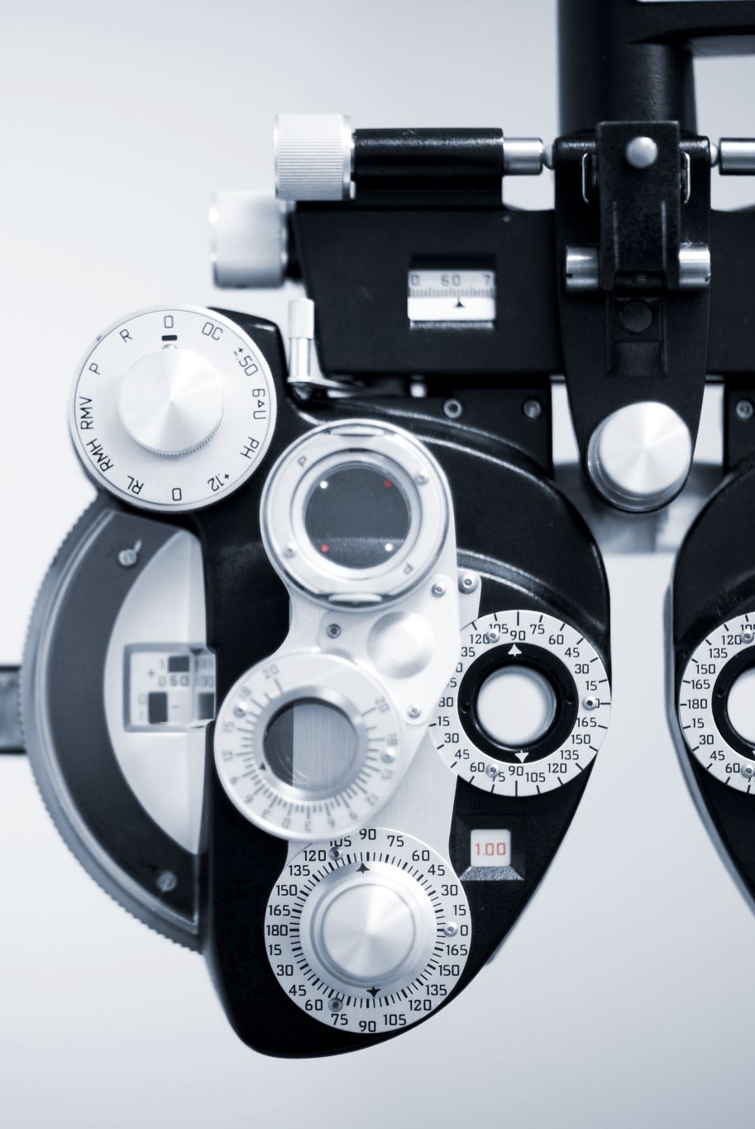
Model 3 - SVM Approach
Uses MTCNN for face detection (Feature Extraction)
PCA for dimensionality reduction
SVM classifier for face recognition
Notes:
The las model is an SVM classifier, using the library MTCNN for feature extraction, PCD for dimensionality reduction and then classify the images using a SVM model

Slide 13
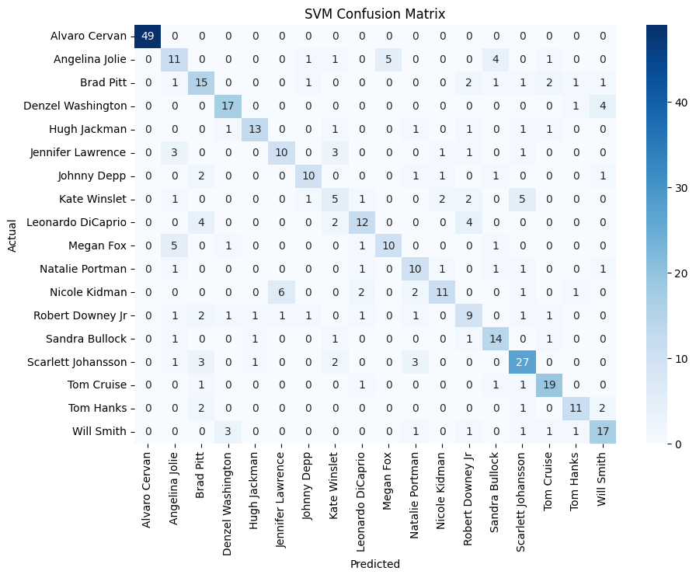
SVM Confusion Matrix
Difficulty with actresses
Overfitting student
Accuracy of 66%
Notes:
The model is simple yet effective, with an accuracy of about 66%.
We can see again that is most likely overfitting the student images because of the source.
We can also notice that actresses have more misclassifications than actors.

Slide 14

Comparing the Three Models
VGG16: 58.6% accuracy, overfitting issues
DeepFace: 73.7% accuracy, very robust
SVM: 66%, lightweight but dependent on preprocessing
Notes:
The first model using VGG16 had less than 60% accuracy and overfitting issues.
Deepface had almost 74% accuracy, more robust in general, lightweight and easy to implement
Lastly the SVM model with 66% accuracy which dependes more on preprocessing of the data

Slide 15
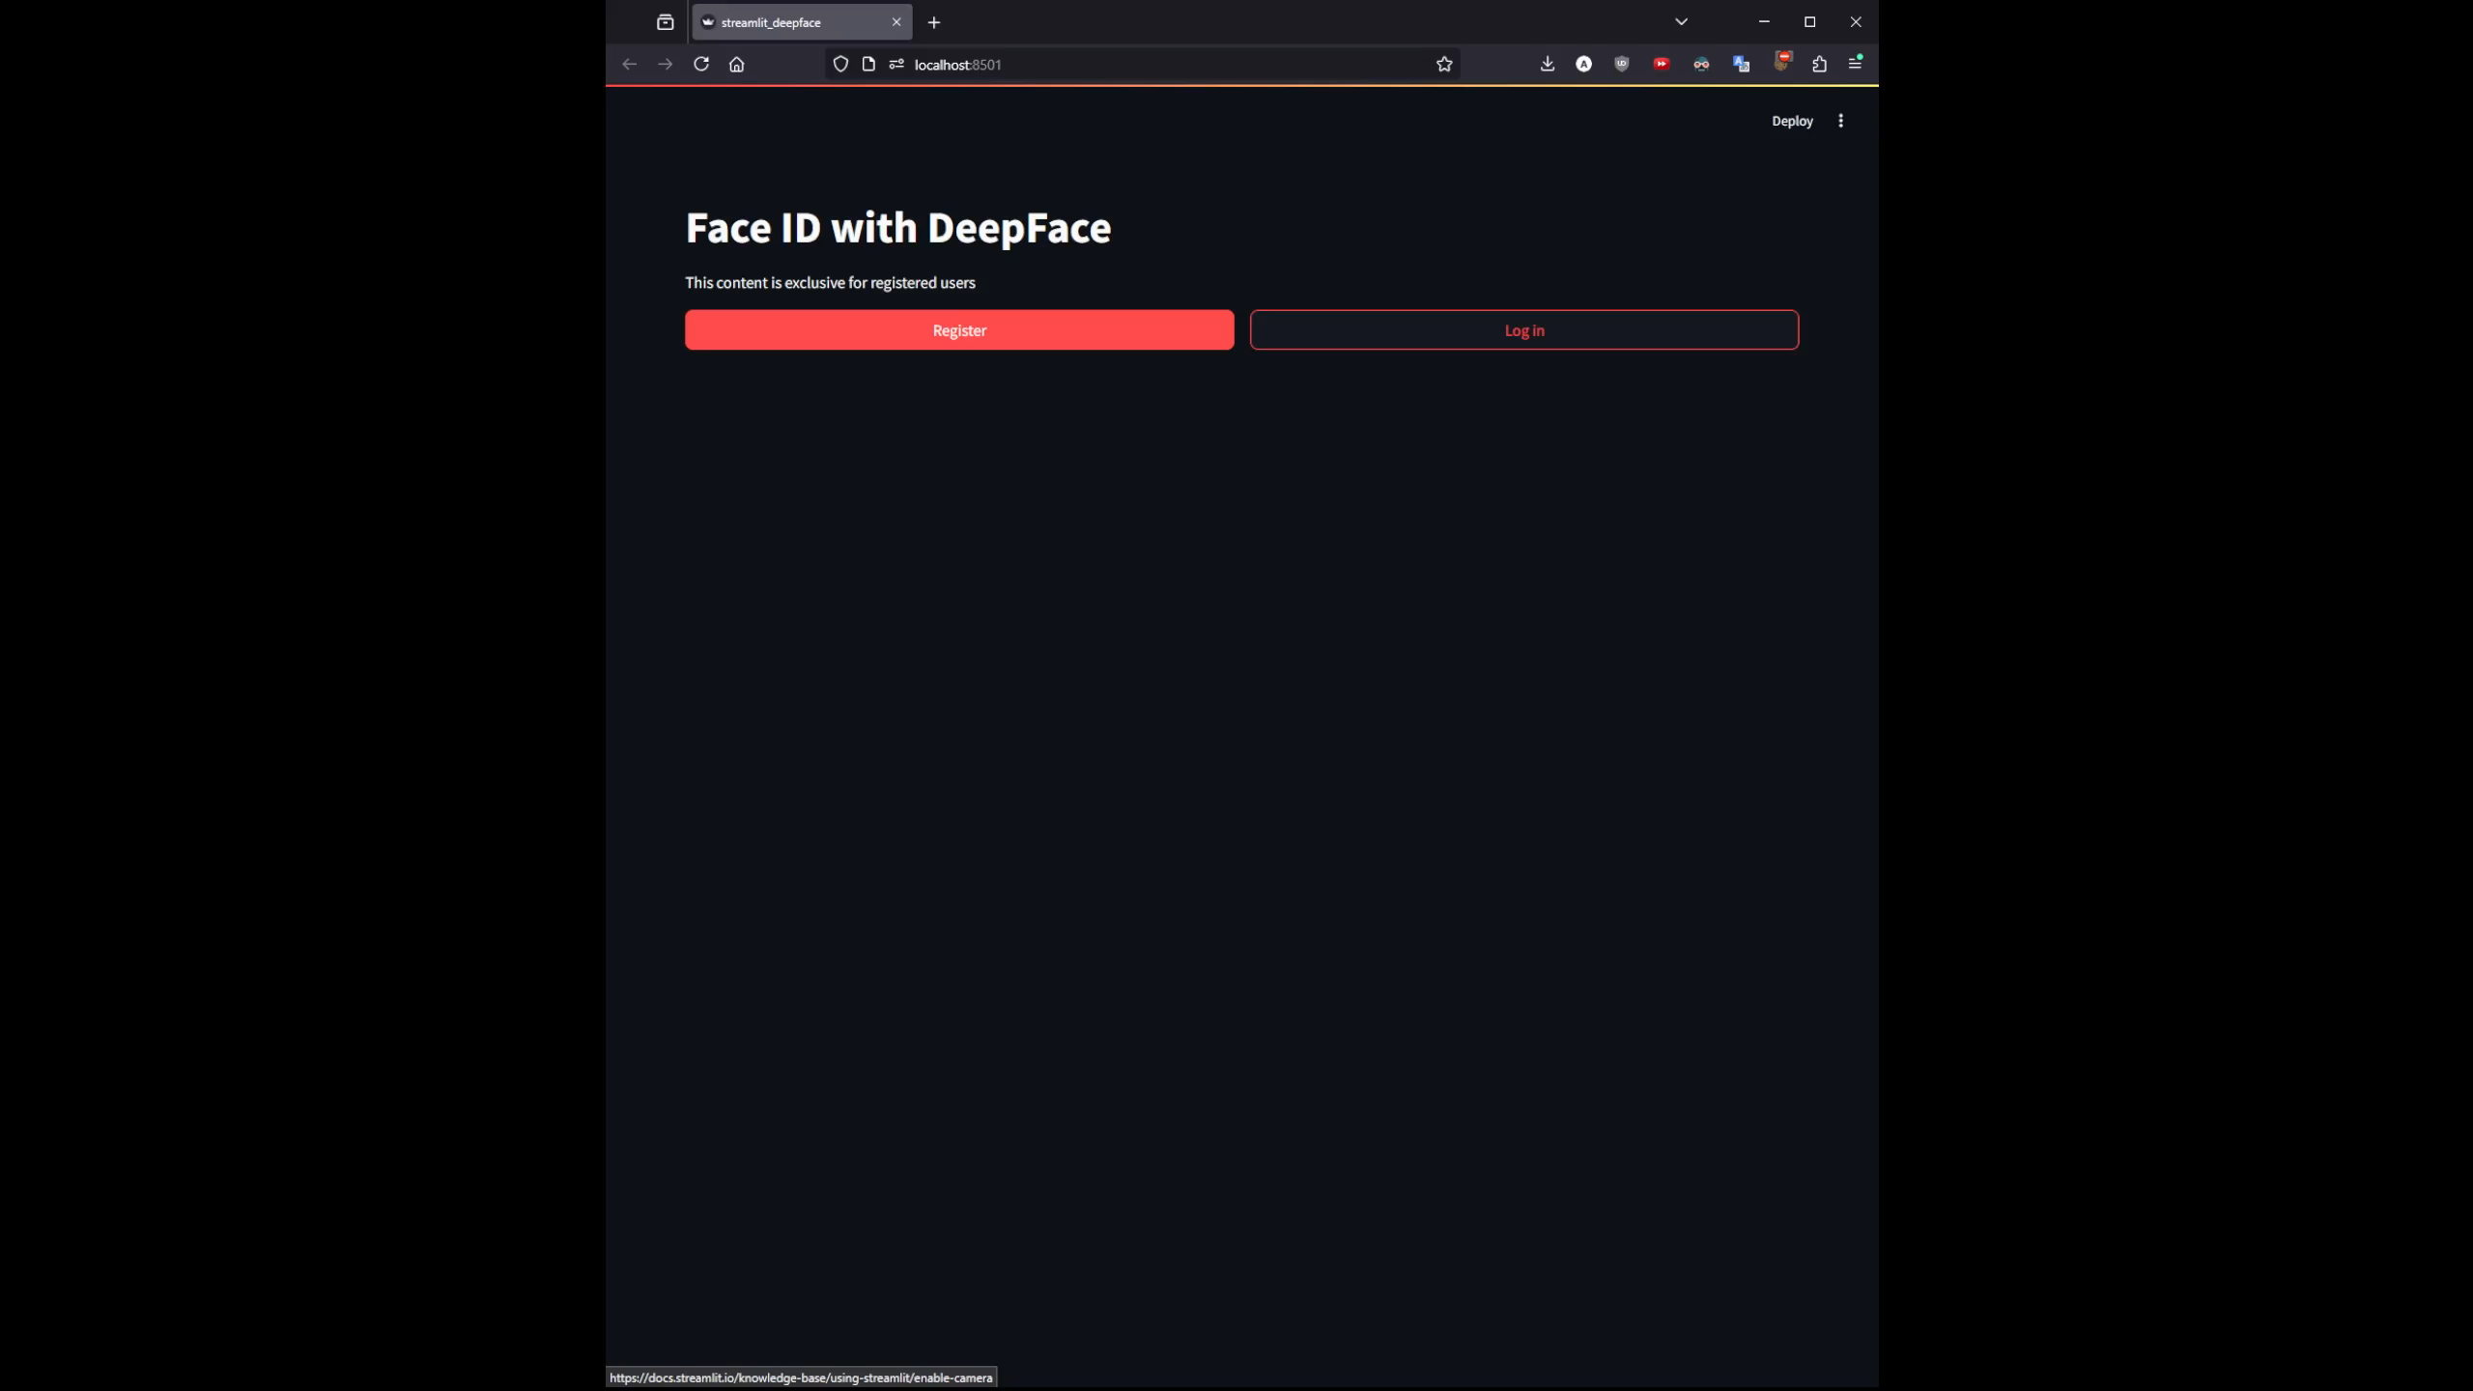
Streamlit Implementation
Notes:
Finally, the moment of truth, the models have been implemented with streamlit on a simple website. At first the website is empty with the option to register or login.
Registering will save your name and image as a new class for deepface. Login will take a picture, either upload of by webcam and compare it to the database, returning the face match if available or error if not found.
Then the page will greet the user, show the uploaded image along with the one from the database as a reference and the content of the site, in this case the jupyter notebook with the code.
The other 2 models are available but do not perform very well. Also depending on the model version (from training sessions) it will vary heavily.

Slide 16
Conclusion & Future Work
Best model: DeepFace
Ease of use
No training necessary for good base level
Small dataset
Possible enhancements:
Data augmentation
Hybrid models
Real-time implementation
Notes:
Finally, we would give the award to best overall model to deepface because of its ease of use, good base level with no training and the small dataset necessary.
Possible enhancements would be to increase the accuracy on the other models by improving the corresponding steps, data augmentation and the real time webcam implementation as intended in the beginning (no picture needed like in smartphones)

Slide 17

Thank You!
Any Questions?
Notes:
Thank you for listening, now if you have any questions I will be happy to answer them.

